Slide 1
In The Cards (Project Blackjack)
By Daulton Nelson
“Feeling Lucky? Go 21 or go home!”

Slide 2
Main Concept
‘In The Cards’ is a gambling game in where players will experience a simulation of the popular casino game Blackjack. Blackjack is a card game where players are drawn cards in order to reach 21, beat the dealer’s hand, or draw if allowed. The player loses if they’re hand totals over 21.

Slide 3
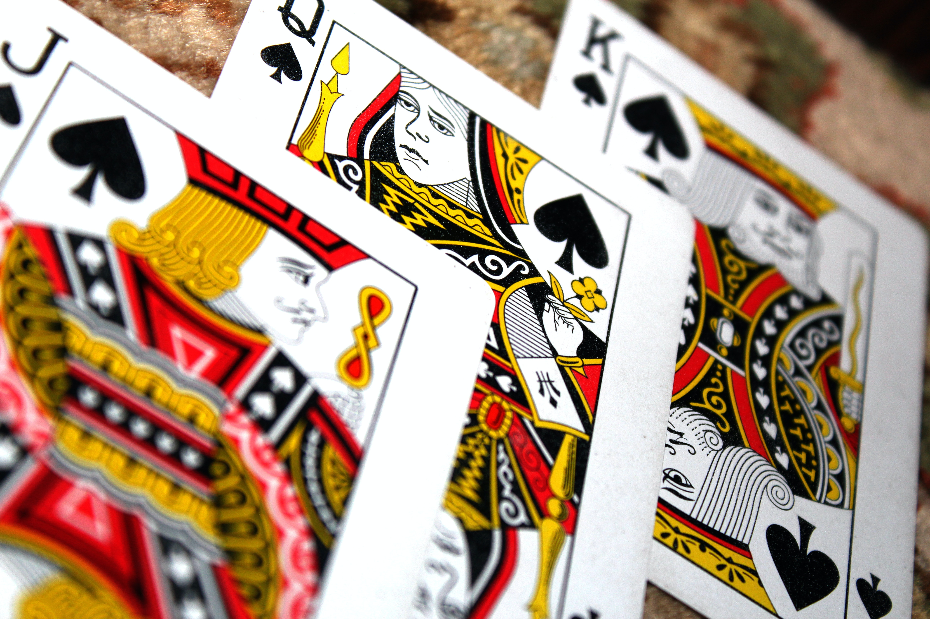
Genre
‘In The Cards’ is a gambling & card game
Perhaps even a puzzle and math game.

Slide 4
Mechanics
The main mechanic deals with players being dealt playing cards valued anywhere form 1 to 11 in the hopes of getting to 21
If they can’t, they must have a higher valued hand than the dealer
If both the dealer’s and the player’s hand are the same value, then the game ends in a draw
If the player’s hand ever reaches a value over 21, they lose

Slide 5
Mechanics
The main mechanic deals with players being dealt playing cards valued anywhere form 1 to 11 in the hopes of getting to 21
If they can’t, they must have a higher valued hand than the dealer
If both the dealer’s and the player’s hand are the same value, then the game ends in a draw
If the player’s hand ever reaches a value over 21, they lose

Slide 6
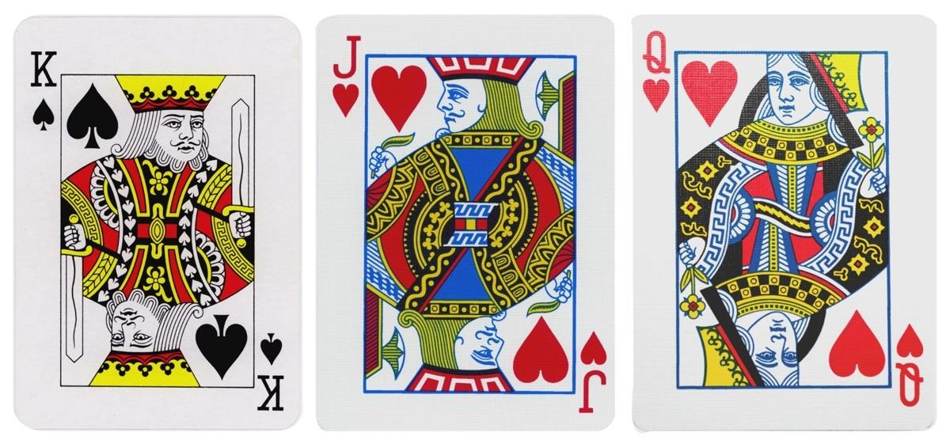
Visualizations 1
Playing Card Faces

Slide 7
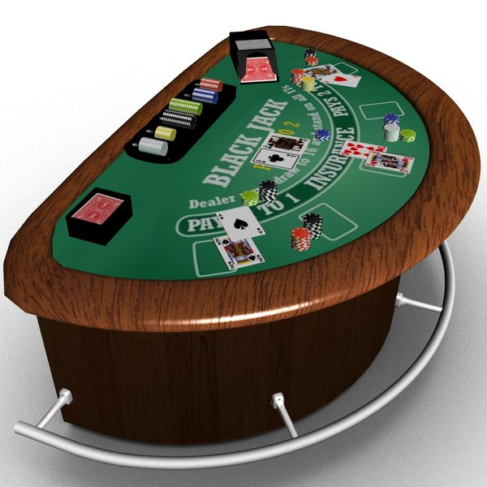
Visualizations 2
Blackjack Table

Slide 8
Target Audience
Gamblers
People who would like to Gamble, but not risk their money
18+ or older
Casino romanticizers
Card Game Enthusiasts

Slide 9
Timeline of Development
Start Date:
  Jan 12, 2022
Expected End Date:
  Mar 27, 2022
Major Milestones
  Creating Custom Assets
  Developing Card Dealing System
  Creating Game Flow
  Developing diegetic UI
  Animation
  Statistics Saving

Slide 10

Staff
Daulton Nelson
  Project Lead
  Programmer
  Artist
  Designer

Slide 11
This work is licensed under a Creative Commons Attribution-ShareAlike 3.0 Unported License.
It makes use of the works of Mateus Machado Luna.

